Slide 1
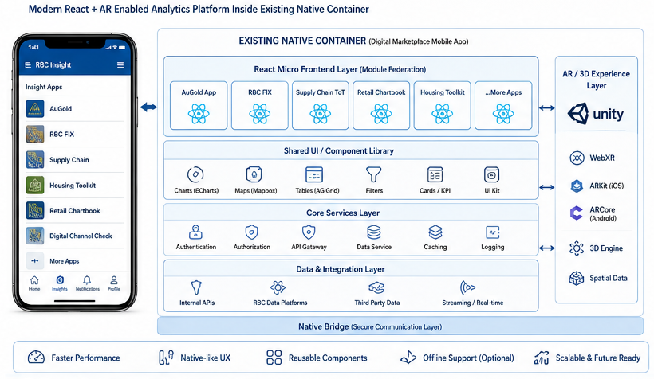
RBC Insight currently operates multiple iframe-based responsive analytics applications embedded inside a native digital marketplace mobile application. While the current architecture delivers analytical functionality, the user experience remains largely “web-dashboard driven” rather than immersive, contextual, and native-grade.
The proposed modernization strategy introduces:
React-based modern micro-frontend architecture
Native-quality mobile interactions
Optional AR/3D immersive visualization layer
Reusable analytical components across apps
Enhanced performance within existing native wrapper/container

Slide 2
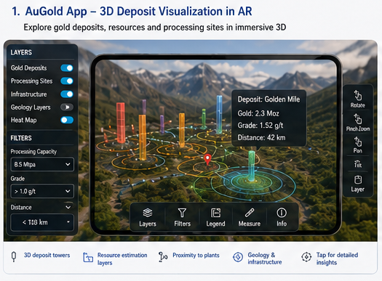


Existing Functionality
GIS-based gold deposit visualization
Deposit proximity analysis
Processing-site radius filtering
Resource distribution analytics
Recommended Modernization
React Layer
Mapbox + Deck.gl
Real-time filtering
Animated clustering
AR Experience
Possible AR Features
3D mine/deposit visualization
Geological layers in AR
Deposit density heat zones
Nearby processing-site overlay
Gesture-driven spatial exploration

Slide 3
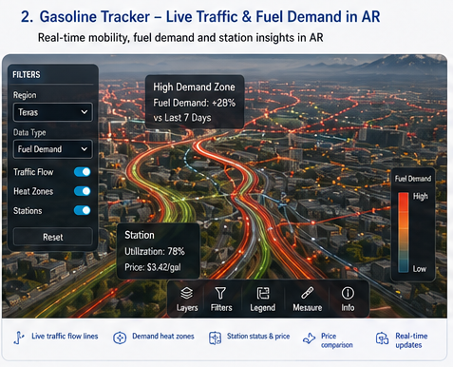
Existing Functionality
Facility distribution across North America.
Company capacity visualization
Multi-industry manufacturing maps.
Recommended AR Features
3D facility clusters
Production network overlays
Supply chain flow visualization
Company capacity “heat towers”
Interactive geographic storytelling.
Why AR Fits
This app already behaves like:
operational geography intelligence
AR enhances:
scale understanding
distribution awareness
operational network visibility

Slide 4
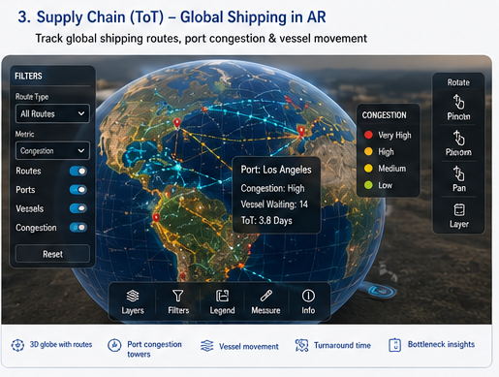
Existing Functionality
Regional fuel demand
Mobility analytics
3D movement trends
Geographic demand overlays.
Recommended AR Features
Live traffic movement layers
Animated route flows
Fuel demand heat zones
3D consumption visualization
Dynamic travel intensity visualization
Why AR Fits
Movement + geography + time-series = excellent immersive candidate.

Slide 5
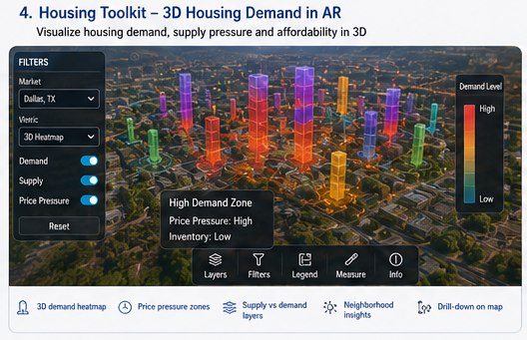
Existing Functionality
Housing demand heatmaps
Supply/demand visualization
Regional housing insights.
Recommended AR Features
City-level demand overlays
3D housing density visualization
Interactive neighborhood comparison
Mortgage pressure visualization

Slide 6
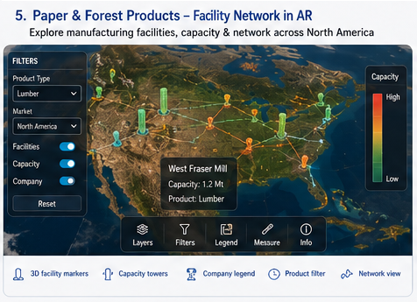
Existing Functionality
Builder pricing trends
Community distribution
Geographic market analytics
Recommended AR Features
3D community overlays
Market hotspot visualization
Home-price density maps
Builder competition layers

Slide 7
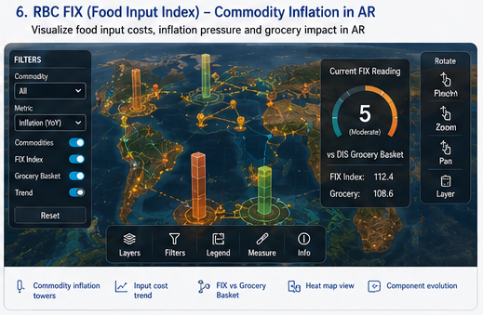
Existing Functionality
Global port congestion tracking
Vessel turnaround analytics
Port operational performance.
Recommended AR Features
3D global shipping routes
Port congestion animation
Vessel movement overlays
Regional bottleneck visualization.
Why AR Fits
Supply chain logistics are inherently spatial.
This becomes:
visually compelling
executive-friendly
immersive operational intelligence

Slide 8
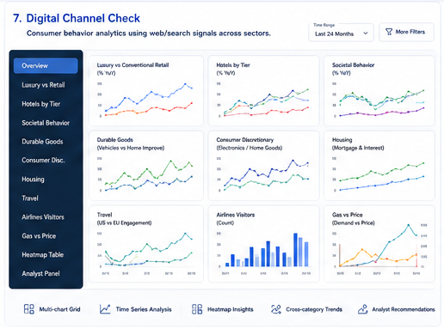
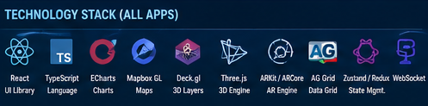
Existing Functionality
Consumer demand trends
Retail engagement tracking
Sector-wise macro behavior
Recommended Experience
Main UX
Modern React analytical dashboard
Optional AR Layer
Floating trend walls
3D retail sector comparison
Animated macroeconomic trend visualization

Slide 9
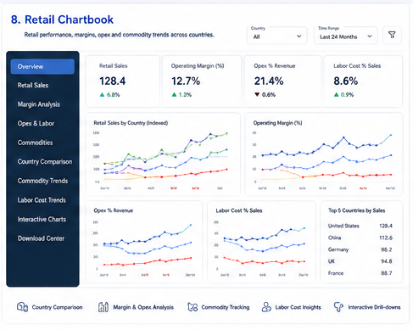
Existing Functionality
Multi-country retail analytics
Margin and Opex tracking
Commodity and labor trends
Recommended AR Features
Global retail heat overlays
Commodity price landscapes
Retail performance comparisons in 3D

Slide 10
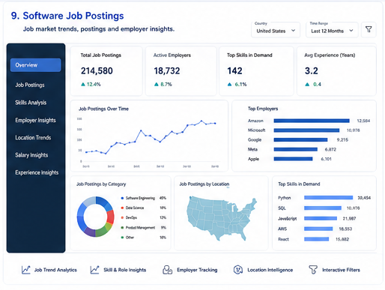
Existing Functionality
Job posting analytics
Employer demand tracking
Technology skill trends
Geographic hiring distribution
Salary insights
Workforce intelligence
AI/GenAI hiring trends
Employer comparison analytics
Recommended Modernization Approach
Primary Direction
Advanced React analytical platform optimized for:
workforce intelligence
trend forecasting
hiring insights
comparative analysis

Slide 11
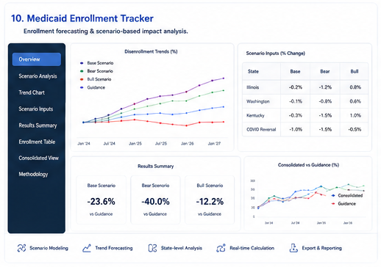
Existing Functionality
Scenario simulation
Enrollment forecasting
State-level calculation engine
Recommendation
Focus on:
interactive simulations
animated forecasting
real-time scenario recalculation
Why AR Is Weak Here
The app is:
logic-heavy
non-spatial
form/simulation oriented

Slide 12
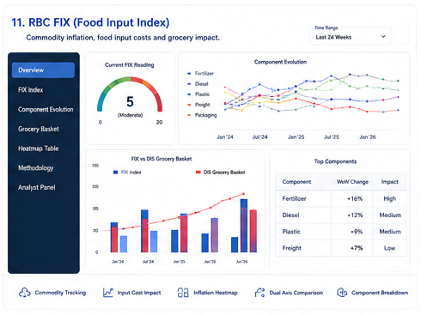
Existing Functionality
Commodity inflation tracking
Food input cost analysis
Grocery basket comparison
Recommended AR Features
Commodity inflation towers
Supply-chain inflation pathways
Interactive commodity landscape
Why AR Can Work
Although chart-heavy, food supply chains have:
geographic relevance
logistics relationships
inflation propagation storytelling

Slide 13
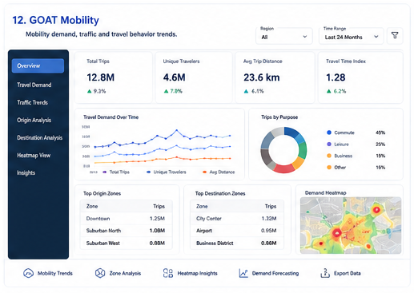
Existing Functionality
travel demand
visitor movement
trip behavior
destination trends
regional mobility patterns
transportation activity
tourism engagement signals
The application combines:
mobility analytics
geographic insights
demand forecasting
behavioral trend analysis
Recommended Experience
Focus areas:
smooth transitions
animated maps
executive storytelling
responsive dashboards
cinematic analytical exploration

